Slide 1

How Speech-Language Pathologists & Audiologists can support OHRC recommendations for Ontario students
Updated December 2021
“The Right To Read”

Slide 2

About Us
OSLA is the unified voice that supports Speech-Language Pathologists and Audiologists practicing in Ontario to enhance the quality of life for Ontarians, especially those with communication disorders, swallowing difficulties, or hearing needs.
Our members are supported according to OSLA’s values statement, which seeks to guide professional development through Patient/Client Well-Being, Respect, Fairness, Commitment to Excellence and Professional Relations.

Slide 3



An Ontario Snapshot
26% of grade 3 children did not meet provincial standards in reading
3.5% of student population has a learning disability, most commonly in reading
54% of those with a learning disability have speech or language difficulties
Notes:
Box 1: https://www.eqao.com/infographic-literacy-trends-ontario-pdf/
Box 2: https://www.ldao.ca/introduction-to-ldsadhd/articles/about-lds/learning-disabilities-statistics/
Box 3: https://www150.statcan.gc.ca/n1/pub/89-628-x/89-628-x2008004-eng.htm#:~:text=Special%20education%20more%20common%20among%20older%20children&text=Indeed%2C%2061.9%25%20of%20children%20aged,children%20aged%205%20to%209

Slide 4
The Ontario Human Rights Inquiry
In October 2019, the OHRC launched a public inquiry into human rights issues that affect students with reading disabilities in Ontario’s public education system.
The goal was to assess whether Ontario is using evidence-based approaches to meet students’ right to read.

Slide 5
The Ontario Human Rights Recommendations
Universal Design
Accessible, evidence-informed instruction for all learners in the classroom
Reading Interventions
Flexible, inclusive, scientific, and timely interventions for those ‘at-risk’
Accommodations
Timely implementation of effective technological & other accommodations
Early Screening
Use of effective measures to identify struggling readers who need more support not later than the end of grade 1
Assessment
Specialist assessments (e.g., psycho-educational) should be available for those continuing to struggle despite high quality support
Notes:
Note: The ‘Assessment’ recommendation mentions ‘Psychoeducational assessment’ only. It is modified slightly in this presentation to ‘specialized assessments’ to allow for representation of SLP assessments. The idea is to advocate for an acknowledgement that SLPs contribute to understanding of struggling readers and writers. For example, dyslexia occurs in about 50% of those with a Developmental Language Disorders (Ref: Adlof & Hogan, 2018, https://pubs.asha.org/doi/10.1044/2018_LSHSS-DYSLC-18-0049)

Slide 6

QUESTION?
How can Speech-Language Pathologists and Audiologists support the OHRC recommendations across schools in Ontario?
Notes:
Note to SLPs: Be familiar with your board’s strategic plan/goals/vision, as well as the literacy approach. Consider how the suggestions here can be aligned with the board’s literacy plan.

Slide 7
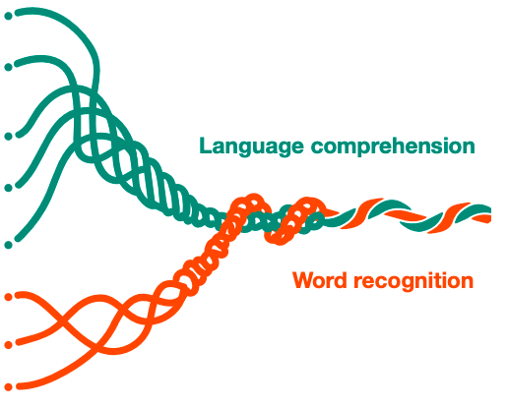

Scientific evidence: Language Basis of Reading
Word Recognition
Language Comprehension
Reading Comprehension
Notes:
Simple View of Reading (Gough & Tunmer, 1986)
This is the model people are referring to when they say ‘the Science of Reading’.
Each of these broad concepts (word recognition; language comprehension) are supported by a number of individual skills (see next slide).

Slide 8
Scientific evidence: Language Basis of Reading
Word Recognition
Phonemic awareness
Decoding
Sight recognition
Fluency
Language Comprehension
Background knowledge
Vocabulary
Language Structures
Verbal Reasoning
Literacy Knowledge
Reading Comprehension
Notes:
Scarborough’s reading rope (2001)
The original version uses the term ‘Listening Comprehension’, which is the same construct as language comprehension (REF: LARRC, 2017, https://pubs.asha.org/doi/10.1044/2017_JSLHR-L-16-0039)
This is consistent with the components of reading instruction identified in ‘The National Reading Panel Report (2000)’: phonemic awareness, phonics, fluency, vocabulary, comprehension (see: https://www.nichd.nih.gov/sites/default/files/publications/pubs/nrp/Documents/report.pdf)

Slide 9
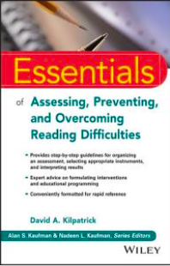
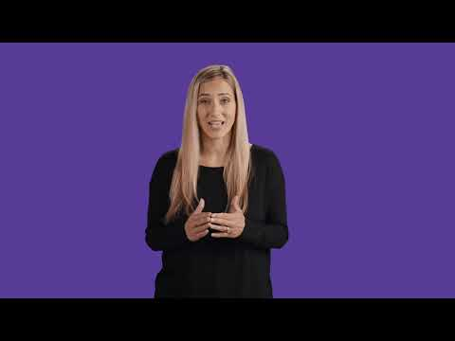
Word Recognition:
Universal Design & Intervention
Phonemic Awareness
The ability to identify and manipulate individual sounds in words.
Proficiency in segmenting & manipulating individual sounds is important for word recognition
Phonemic awareness must be taught explicitly
Struggling readers of any age should work on phonemic awareness if these skills are not mastered
Notes:
David Kilpatrick’s book is an excellent resource, and provides ‘One minute PA activities’ for daily use in the classroom.

Slide 10
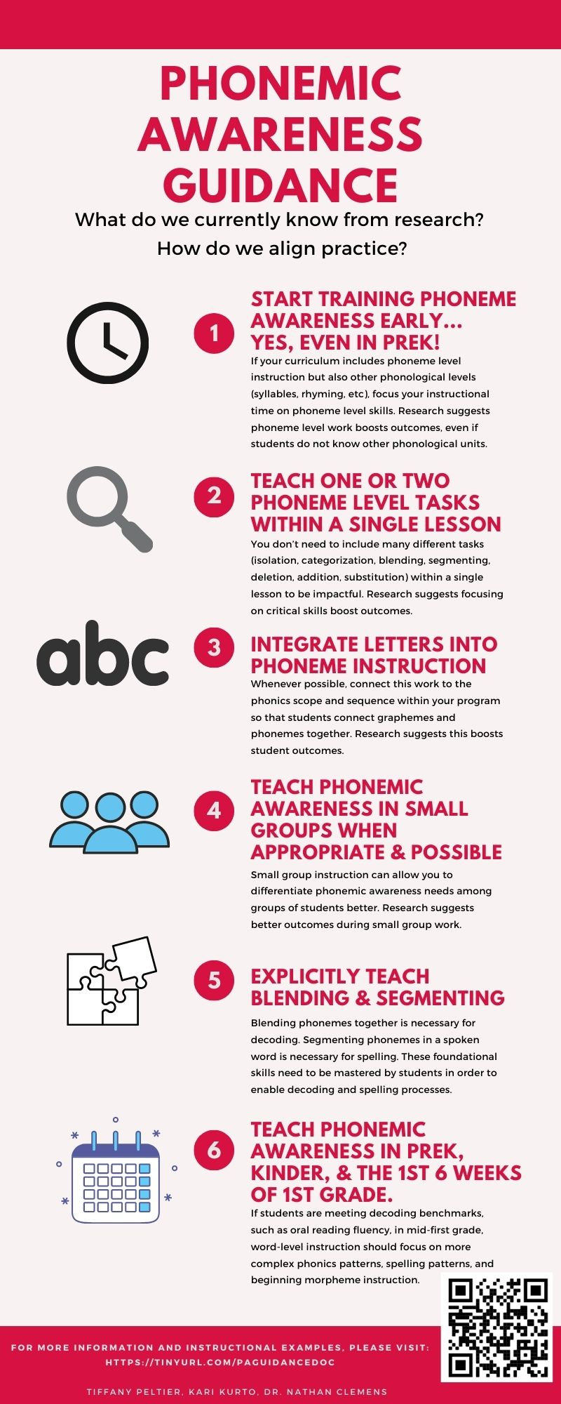
Word Recognition:
Universal Design & Intervention
Phonemic Awareness
Start training phonemic awareness early & focus on phoneme level
Focus on 1 or 2 tasks (isolation, categorization, blending, segmenting, deletion, addition, substitution)
Integrate letters into activities
Differentiate through small groups, when possible
Explicitly teach blending & segmenting (advanced skills used in reading)
With systematic, intensive practice, most students will master PA skills by mid-grade 1. Monitor progress. Move to more advanced skills as appropriate.
Notes:
https://understandingreading.home.blog/resources/
An early focus on blending and segmenting sounds
with letters will support learning to read. After that, reading itself will further develop PA skills. A prolonged focus on PA manipulation skills without letters prior to reading instruction is not warranted.
For struggling readers, short-term, intensive
PA intervention (with letters) is expected to be of benefit if assessment indicates difficulties with foundational, word-level skills.

Slide 11
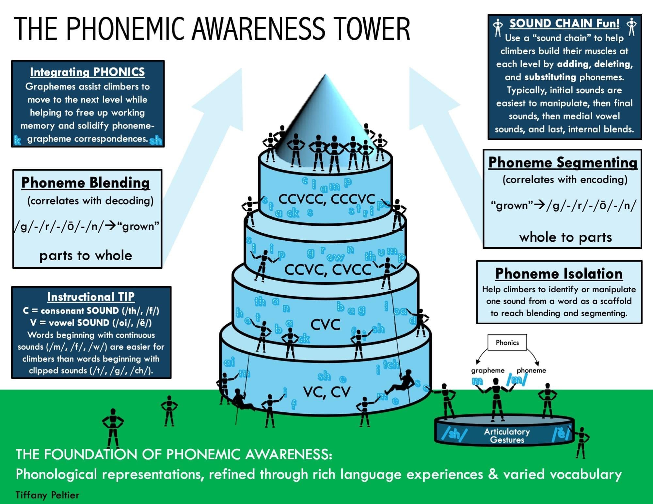
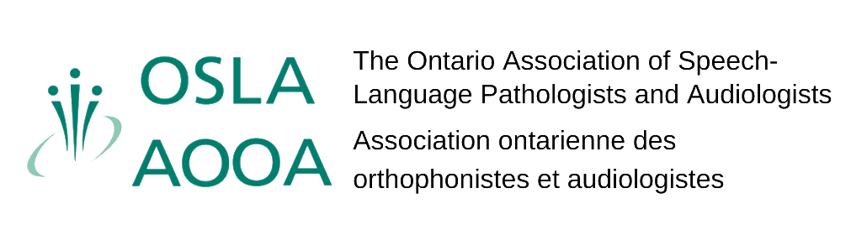
Phonemic Awareness
Notes:
https://understandingreading.home.blog/resources/

Slide 12
Word Recognition:
Universal Design & Intervention
Phonics
Explicit, systematic instruction in the relations between graphemes (letters) and phonemes (sounds)
Systematic: Follows a logical instructional sequence of grapheme-phoneme correspondences
Phonemic Awareness
Decoding
Grapheme-Phoneme Relations
Orthographic Mapping
Spelling (sound-write)
READ A WORD
Convert graphemes to phonemes & then blend
WRITE A WORD
Segment phonemes & convert to graphemes
Notes:
Orthographic mapping - the processing of mapping (connecting) the phonemes (sounds) a child knows to the graphemes (letters) in a word (spelling) so that it is permanently stored (along with the word’s meaning) in the brain and is ‘instantly recognizable’ as a ‘sight word’. Sight words are any word that can be easily recognized without conscious effort (regardless of whether it follows common phonics patterns). Sight recognition reduces the cognitive load of single word reading so more cognitive resources can be directed to understanding the text. (See also, Early reading: How children learn to decode - https://youtu.be/GxHHOtcWaTA and Early reading: When decoding breaks down - https://youtu.be/2NwWRz0zKuw)

Slide 13
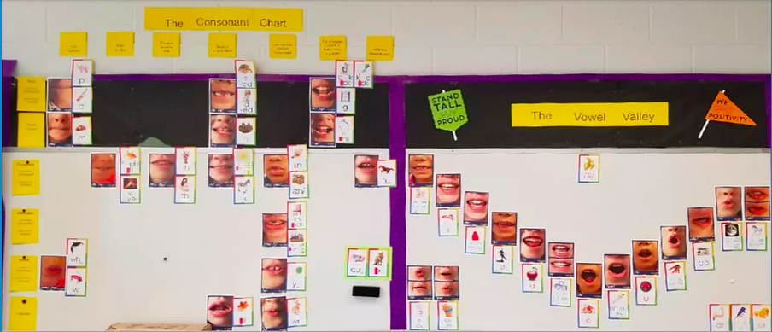
Word Recognition:
Universal Design & Intervention
Phonemic Awareness
Phonemic Awareness & Phonics Together!
Working with sounds + letters = Phonemic Awareness + Phonics
✓
Decoding
Sight Recognition
A sound wall can act as a guide during instruction
Notes:
https://shanahanonliteracy.com/blog/should-we-build-a-word-wall-or-not
Sound wall picture source: https://www.tools4reading.com/sound-walls
https://www.readingrockets.org/article/transitioning-word-walls-sound-walls

Slide 14
Word Recognition:
Universal Design & Intervention
Phonemic Awareness
Text Reading Practice to Build Fluency
Reading words aloud to activate grapheme-phoneme correspondences
Reading decodable texts focusing on grapheme-phoneme relations relevant to instruction
Decoding
Sight Recognition
Repeated reading to read at about the pace of oral language & in a way that sounds natural
Spelling words to highlight the connection between graphemes & phonemes
Notes:
Decodable texts - texts that include words that can be easily ‘sounded out’ or decoded using the letter-sound combinations the child is currently learning https://www.spelfabet.com.au/2018/05/what-is-a-decodable-book/
https://understandingreading.home.blog/2021/04/18/dr-linnea-ehris-list-of-instructional-guidelines-for-enhancing-orthographic-mapping-and-word-learning/
https://shanahanonliteracy.com/blog/everything-you-wanted-to-know-about-repeated-reading

Slide 15
Word Recognition:
Universal Design & Intervention
Phonemic Awareness
Word Recognition Teamwork!
Educators + SLPs working together = more support for the whole class and/or targeted groups
✓
Decoding
Sight Recognition
Print Awareness
Notes:
Print Awareness - knowledge of the function of print as well as print & book conventions (e.g., a capital marks the beginning of a sentence)

Slide 16
Word Recognition:
Screening Examples | Assessment
Phonological Awareness Screening Test https://www.thepasttest.com/ | In this area, speech, language, and communication assessments: Focus on phonemic awareness Consider speech production & phonological processing
Letter-sound knowledge
Graded, common word reading lists
Phonemic Awareness
Decoding
Sight Recognition

Slide 17
Scientific evidence: Language Basis of Reading
Word Recognition
Phonemic awareness
Decoding
Sight recognition
Fluency
Language Comprehension
Background knowledge
Vocabulary
Language Structures
Verbal Reasoning
Literacy Knowledge
Reading Comprehension
Notes:
Scarborough’s reading rope (2001)
The next slides focus on language comprehension

Slide 18
Language Comprehension:
Universal Design & Intervention
Background Knowledge
Explicitly teach the words & concepts students needs now - “point of contact” learning
Present student-friendly definitions, pictures; connect spoken & written forms
Encourage translations & connections with home language
Vocabulary
Facilitate deep understanding & rich connections by teaching words with related meanings
Incorporate lots of opportunities to repeat, contrast & compare through instruction, games, books, play
*36 times!
*Research suggests that students struggling to learn language need to hear a new word 36 times! And then review again at other times!
Notes:
Oral Language at Your Fingertips: Chapter 4 - Vocabulary
Infographic summarizing the ‘36 exposures’ finding: https://wordlearning.ku.edu/current-findings
Culturally & linguistically responsive vocabulary approach for young dual language learners: https://pubs.asha.org/doi/abs/10.1044/2014_JSLHR-L-12-0221
Plurilingual approach to teaching English: https://theconversation.com/its-time-to-change-the-way-we-teach-english-109273?utm_source=twitter&utm_medium=bylinetwitterbutton

Slide 19
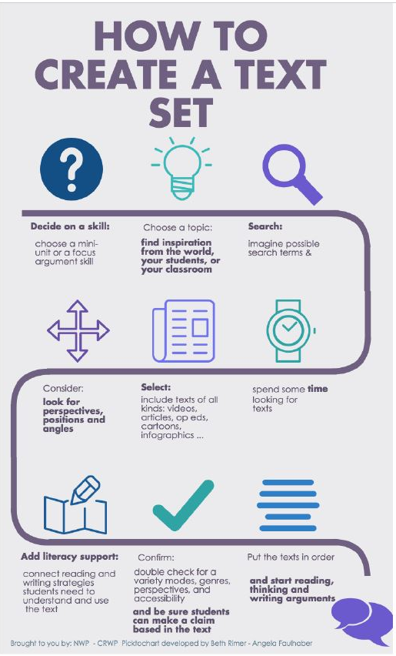
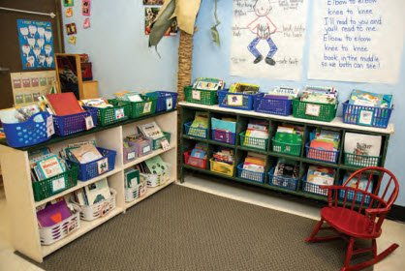
Language Comprehension:
Universal Design & Intervention
Use text sets focused on a topic:
Books provide an anchor for vocabulary, concepts, & conversations
Multiple genres: narratives (tells a story), expository (gives facts)
Varying perspectives; diverse representation
Background Knowledge
Vocabulary
✓Organize your leveled texts by topic!
Notes:
Oral Language at Your Fingertips: Chapter 6 - Text Structure
https://libguides.geneseo.edu/c.php?g=67346&p=434759
https://sites.google.com/site/1516nwpcrwp/home/creating-a-text-set
https://www.cultofpedagogy.com/leveled-texts/
Sources of culturally & linguistically diverse books: https://linktr.ee/diversebooks4SLPs and http://med-fom-audiology.sites.olt.ubc.ca/files/2016/07/Book-list.pdf

Slide 20
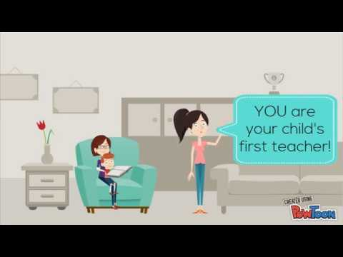
Language Comprehension:
Universal Design & Intervention
Background Knowledge
Book sharing OR Dialogic Reading
Choose books that include the words & concepts your students are learning
Emphasize these targets when you’re reading
Plan & use question prompts to engage students in turn-taking throughout the story reading
  Give meaning (student-friendly definitions)
  Build bridges to what students already know
  Extend thinking (‘challenge thinking’)
Extra-textual talk - conversations that surround the book reading; facilitate & extend children’s understanding
Vocabulary
Language Structures

Slide 21

Language Comprehension:
Universal Design & Intervention
Teacher Talk!
Vocabulary
Teachers’ use of complex syntax during instructional activities is linked to children’s grammar & vocabulary learning (Farrow et al., 2020)
When teachers use *mental state verbs in sentences, they use more complex syntax (Owen Van Horne et al., 2017)
Don’t forget to differentiate for struggling learners:
Say, ‘I wonder if this will fall now’
Then say & gesture, ‘I’m wondering’ AND ‘This might fall’
Point/show pictures
Language Structures
*mental state or ‘cognitive’ verbs are verbs related to the mind like know, think, learn, understand, feel, hope, prefer
Notes:
Oral Language at Your Fingertips: Chapter 5 - Word and Sentence Structure
Farrow et al: https://www.sciencedirect.com/science/article/abs/pii/S0885200619301139
Owen Van Horne et al: https://journals.sagepub.com/doi/abs/10.1177/0265659017734336

Slide 22
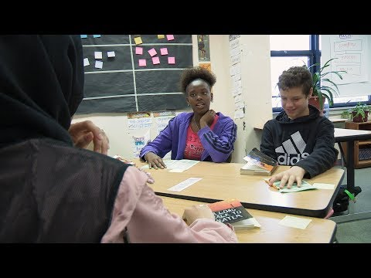
Language Comprehension:
Universal Design & Intervention
Use Classroom Talk Moves
Repeat
Adding on
Clarify
Agree/disagree
Check for understanding
Sentence starters that help students participate verbally.
Vocabulary
Language Structures
Also see, Language Rich Curriculum: https://larrc.ehe.osu.edu/; Oracy in the classroom: https://www.edutopia.org/video/oracy-classroom-strategies-effective-talk
Notes:
Oral Language at Your Fingertips: Chapter 2 - Oral Language Interactions in the Classroom
This is the best video, but it requires a subscription: https://learn.teachingchannel.com/video/student-participation-strategy
You can view some of it on this site (see bottom half of page): https://www.smekenseducation.com/require-students-to-listen-during-conversations-with-talk-moves/
This is another good one (with somewhat younger children): https://www.edutopia.org/article/what-productive-talk-looks-elementary-grades

Slide 23
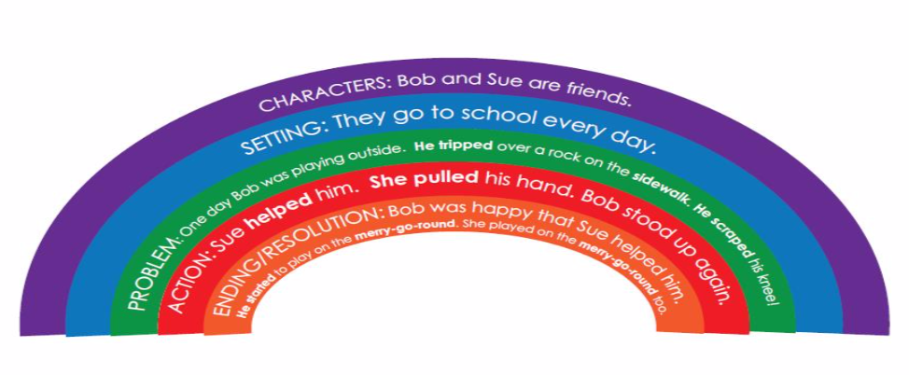
Language Comprehension:
Universal Design & Intervention
Explicitly teach text structure
Background Knowledge
Vocabulary
Language Structures
Verbal Reasoning
Literary Knowledge
Narrative structure
E.g., https://www.languagedynamicsgroup.com/story-champs/
Expository text structure too: problem-solution; description; compare-contrast; cause-effect; chronological/sequence
Notes:
Oral Language at Your Fingertips: Chapter 6 - Text Structure
This graphic was taken from Tiffany Hogan’s Reading League talk on the Language Basis of Reading: Assessment and Instruction (https://thereadingleague.uscreen.io/programs/january-9-2020-the-language-basis-of-reading-assessment-and-instruction-for-language-comprehension-396256-83e9ee). No further source notes for the graphic were provided.

Slide 24
Language Comprehension:
Universal Design & Intervention
Higher-level Language Skills
Inferencing
  Use background knowledge to fill in the gaps
  E.g., https://meadowscenter.org/files/projects/Inferences_SampleLessons.pdf
Comprehension monitoring
  Periodic summaries
  Think alouds
  Stop and draw
Background Knowledge
Vocabulary
Language Structures
Verbal Reasoning
Literary Knowledge
Notes:
Oral Language at Your Fingertips: Chapter 7 - Language Comprehension and Inferencing

Slide 25
Language Comprehension:
Screening Examples | Assessment
Language screeners: https://docs.google.com/spreadsheets/d/1z0qD63oKuJ53MR5VPWkdARqHStutOjh_c0eQY6SA3Ak/edit#gid=0 | In this area, speech, language, and communication assessments focus on: Morphology Syntax Semantics Pragmatics Verbal learning & memory Considerations: cultural & linguistic diversity, among other factors
CUBED (decoding & narrative language) https://www.languagedynamicsgroup.com/cubed/cubed_download/ http://trinastoolbox.com/
Background Knowledge
Vocabulary
Language Structures
Verbal Reasoning
Literary Knowledge
Notes:
Oral Language at Your Fingertips: Chapter 7 - Language Comprehension and Inferencing

Slide 26

How Can We Help?
Collaborate to implement universal designs & screening for the language basis of reading
Assist in determining the most effective accommodations for individual students
Provide specialist assessment of speech, language, and communication
Notes:
Oral Language at Your Fingertips: Chapter 8 - Partnerships

Slide 27
Education Exceptionalities
Communication -
Autism
Deaf and Hard of Hearing
Language Impairment
Speech Impairment
Learning Disability
Intellectual -
Gifted
Mild Intellectual Disability
Developmental Disability
Behavioural
Multiple

Slide 28
Clinical Profiles of Children with Communication Disorders
Speech Sound Disorders
Difficulty with perception, motor production, or phonological representation of speech sounds and segments
Developmental Language Disorder (DLD)
Persistent language difficulty with a significant impact on school learning & everyday activities
Phonology
Grammar
Semantics/Understanding
Pragmatics/Social Use of Language
Verbal learning & memory
See radld.org; dldandme.org
Language Disorder associated with biomedical conditions
Language disorder as part of condition with a complex trait pattern including, for example:
ASD
Sensori-neural hearing loss
Intellectual disability
Others
Difficulties with fluent speech production, voice, or other aspects of oral or written communication

Slide 29




Find out more...
/OSLAOntario
/OSLA_Ontario
/OSLA
osla.on.ca
Connect with us at: mail@osla.on.ca

Slide 30
Thank you.
Notes:
Examples:
The big 6 - Let’s Get Started: https://principals-of-reading.com/?p=23
Literacy Assessment Schedule: https://www.eminamclean.com/post/developing-a-literacy-assessment-schedule

Slide 31
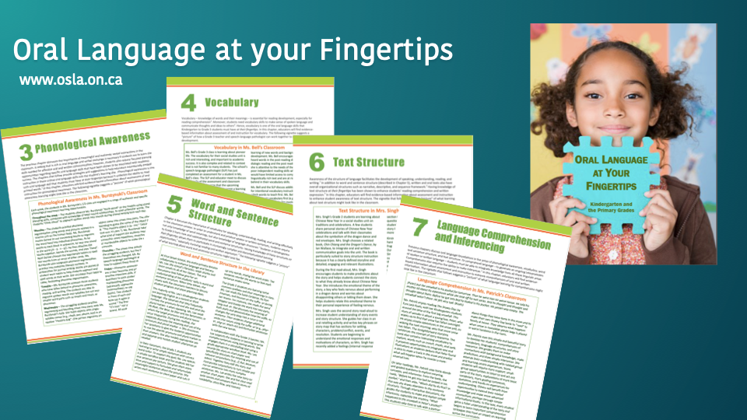
Credits:
This presentation was developed by Professor Lisa Archibald - Associate Professor, The University of Western Ontario, in consultation with members of the OSLA School Services Committee, OSLA Executive, and based on feedback from the Association of Chief Speech Language Pathologists of Ontario District School Boards
This presentation may be modified without permission provided the original version credited is given
Notes:
This is an optional slide you can incorporate into your presentation. Please refer to the guide for additional details.

